Slide 1
Building Trust: Secure and Efficient ID Verification
Session 18
Presented by Linda Putu

Slide 2
Welcome, my fellow collegues, to a journey of transformation!!!
Notes:
"Welcome, everyone.
game-changing solution
innovative features
our primary goal is to streamline the ID verification
process and enhance its effectiveness.

Slide 3
The new pain for Institutions

Slide 4
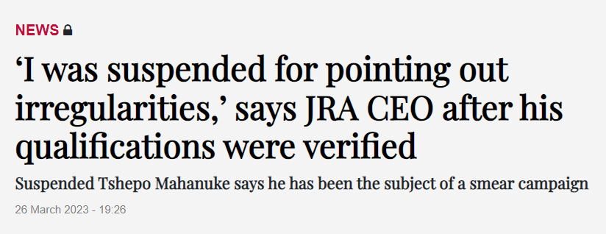
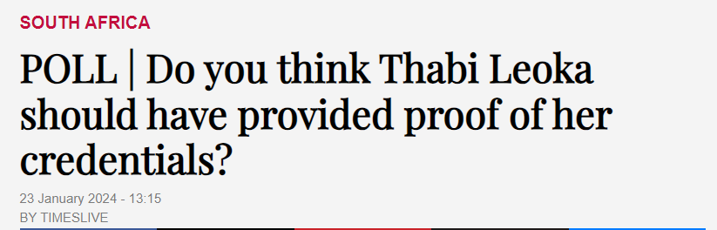
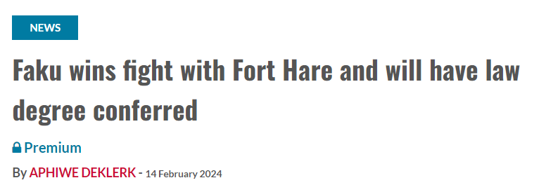
Why ID Verification

Slide 5
Navigating ID Verification Challenges
Identity Theft Threats
Fraudulent Document Submission
Multiple ID Instances
Data Quality and Accuracy
Regulatory Compliance
Notes:
Remove Diverse ID Formats
1 out of 60 Problem
Inline verification
Newspaper article on ID Ver – Value of incident, cost in admin. Press Conference
Technical and Why we doing that
This may not affect you now, until it does

Slide 6
Elevating the ID Verification Experience: Overview
ID Verification Process:
Student's ID sent to DHA for verification.
Response Handling:
DHA's reply stored on SREGB-1.
Validation Status:
Response categorized as valid or invalid.

Slide 7
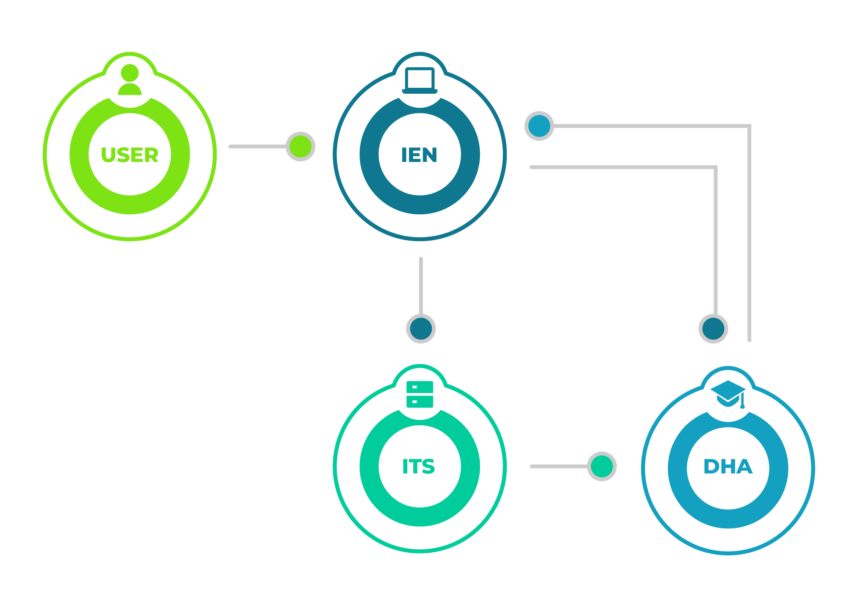
Elevating the ID Verification Experience: Workflow
Valid Response:
If the response is valid, the verification process is complete.
Invalid Response:
For an invalid response, students can visit iEnabler.
Student Verification on iEnabler:
Students verify their data with existing DHA information.
Second DHA Verification:
Data re-verified at DHA based on student's input.

Slide 8
Benefits
Efficient and Secure:
"Our solution ensures an efficient and secure ID verification process, minimizing errors and improving overall accuracy."
Improved Data Integrity:
"With streamlined processes and enhanced verification mechanisms, we guarantee improved data integrity."
Enhanced Communication Channels:
"Administrators and students benefit from enhanced communication channels, ensuring quick and effective feedback."

Slide 9
Are you ready to transform?
Notes:
Find me, hunt me down

